Slide 1
Session 9: Testing of Hypothesis
II Semester 2019 -20(November 2020)

Slide 2
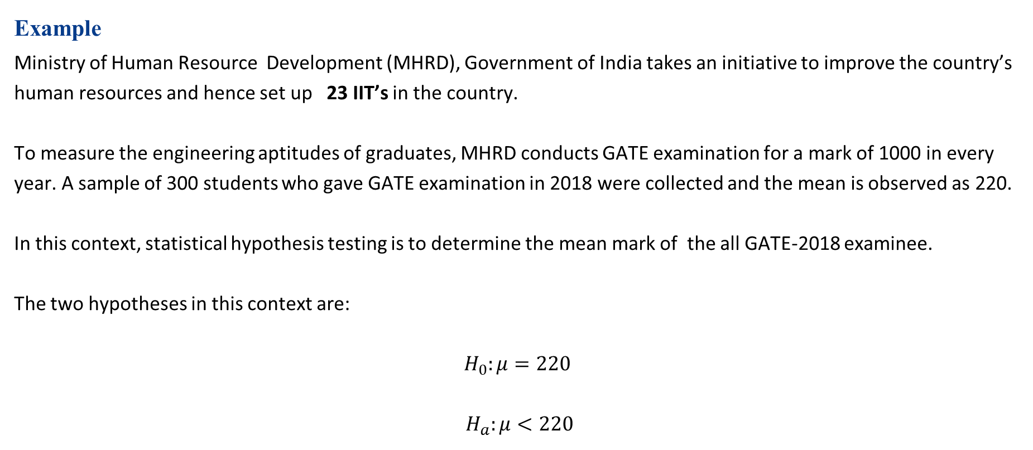
The Hypotheses
Example
Ministry of Human Resource Development (MHRD), Government of India takes an initiative to improve the country’s human resources and hence set up 23 IIT’s in the country.
To measure the engineering aptitudes of graduates, MHRD conducts GATE examination for a mark of 1000 in every year. A sample of 300 students who gave GATE examination in 2018 were collected and the mean is observed as 220.
In this context, statistical hypothesis testing is to determine the mean mark of the all GATE-2018 examinee.
The two hypotheses in this context are:
$$H_{0}:μ=220$$
$$H_{a}:μ<220$$

Slide 3
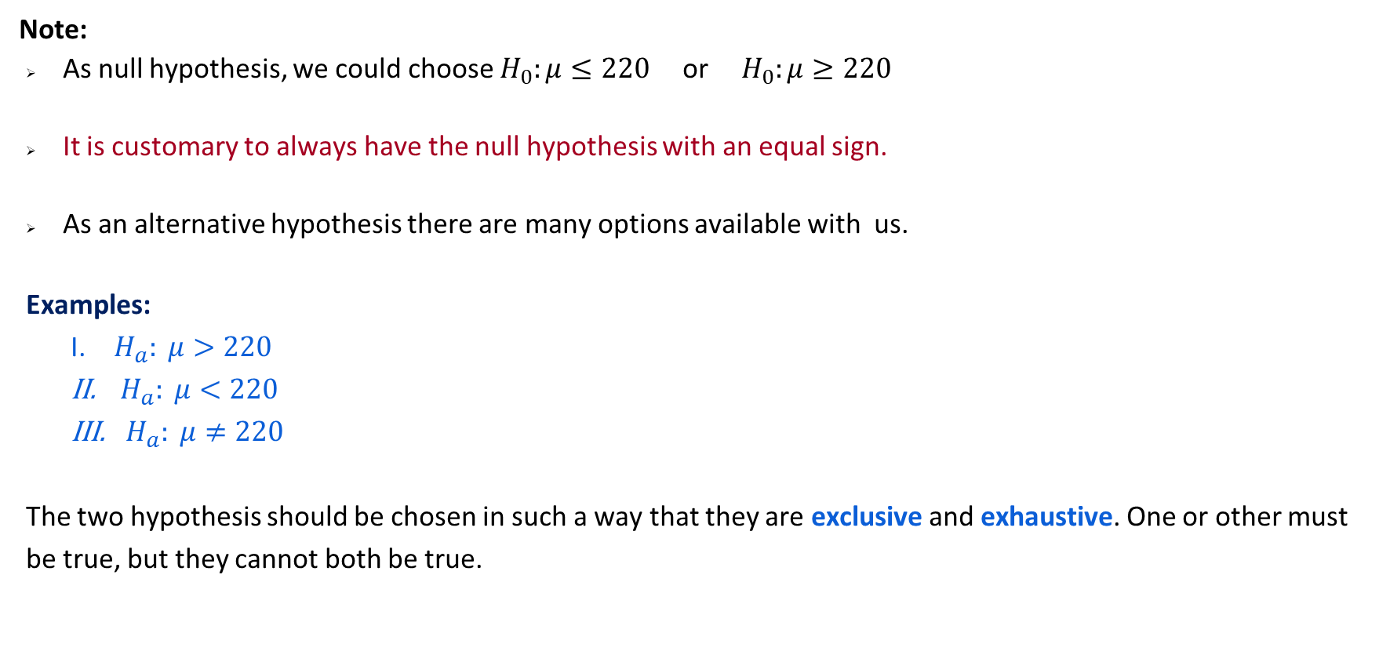
The Hypotheses
Note:
As null hypothesis, we could choose $H_{0}:μ≤220$or${ H}_{0}:μ≥220$
It is customary to always have the null hypothesis with an equal sign.
As an alternative hypothesis there are many options available with us.
Examples:
$H_{a}: μ>220$
${ H}_{a}: μ<220$
${ H}_{a}: μ≠220$
The two hypothesis should be chosen in such a way that they are exclusive and exhaustive. One or other must be true, but they cannot both be true.

Slide 4
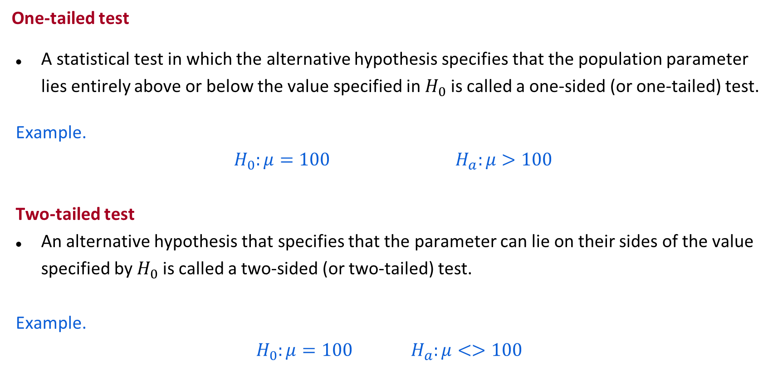
The Hypotheses
One-tailed test
A statistical test in which the alternative hypothesis specifies that the population parameter lies entirely above or below the value specified in $H_{0}$ is called a one-sided (or one-tailed) test.
Example.
$H_{0}:μ=100$ $H_{a}:μ>100$
Two-tailed test
An alternative hypothesis that specifies that the parameter can lie on their sides of the value specified by $H_{0}$ is called a two-sided (or two-tailed) test.
Example.
$$H_{0}:μ=100 H_{a}:μ<>100$$

Slide 5
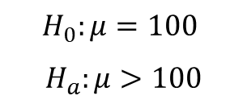
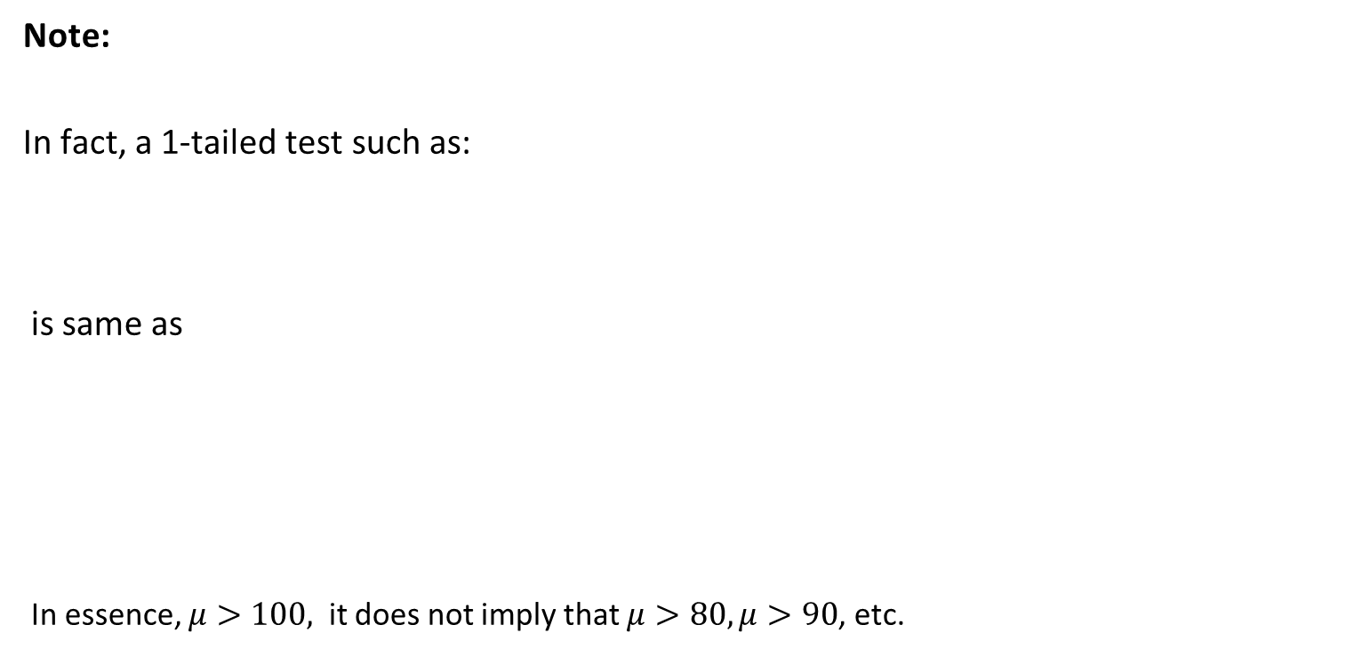
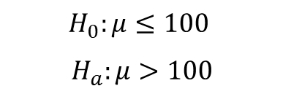
The Hypotheses
Note:
In fact, a 1-tailed test such as:
is same as
In essence, $μ>100,$ it does not imply that $μ>80,μ>90$, etc.
$$H_{0}:μ=100$$
$$H_{a}:μ>100$$
$$H_{0}:μ≤100$$
$$H_{a}:μ>100$$

Slide 6
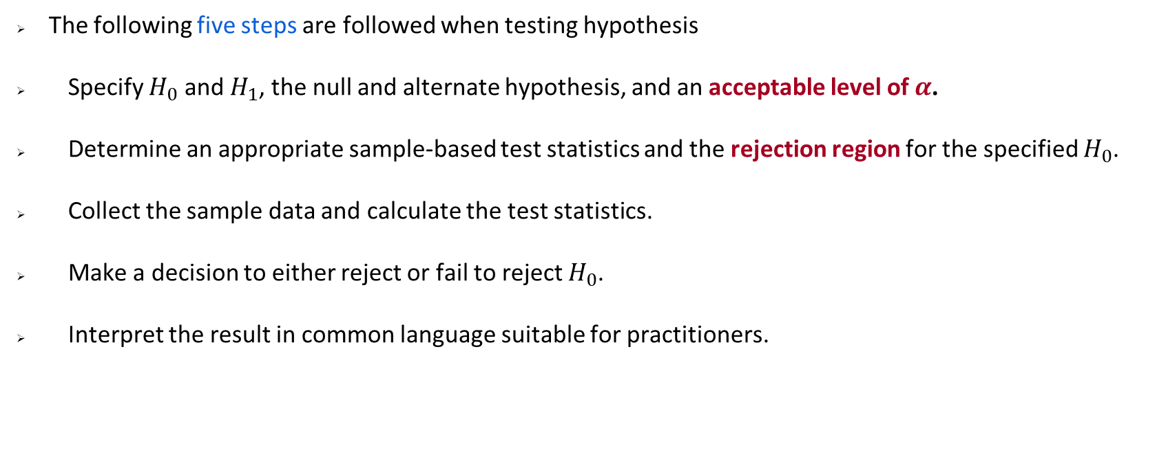
Hypothesis Testing Procedures
The following five steps are followed when testing hypothesis
Specify $H_{0}$ and $H_{1}$, the null and alternate hypothesis, and an acceptable level of $α$.
Determine an appropriate sample-based test statistics and the rejection region for the specified $H_{0}$.
Collect the sample data and calculate the test statistics.
Make a decision to either reject or fail to reject $H_{0}$.
Interpret the result in common language suitable for practitioners.

Slide 7
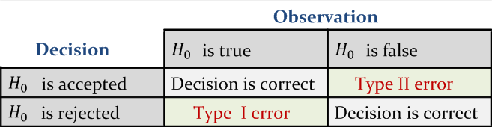
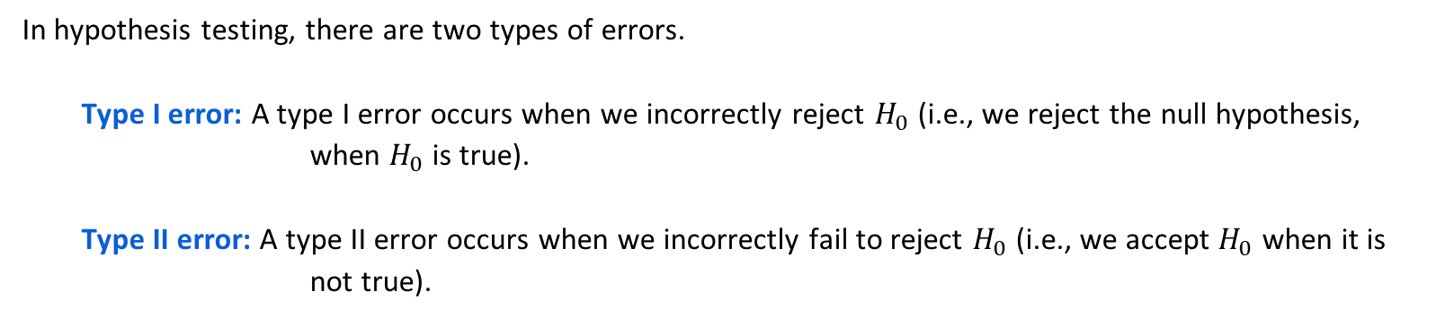
Errors in Hypothesis Testing
In hypothesis testing, there are two types of errors.
Type I error: A type I error occurs when we incorrectly reject $H_{0}$ (i.e., we reject the null hypothesis, when $H_{0}$ is true).
Type II error: A type II error occurs when we incorrectly fail to reject $H_{0}$ (i.e., we accept $H_{0}$ when it is not true).

Slide 8
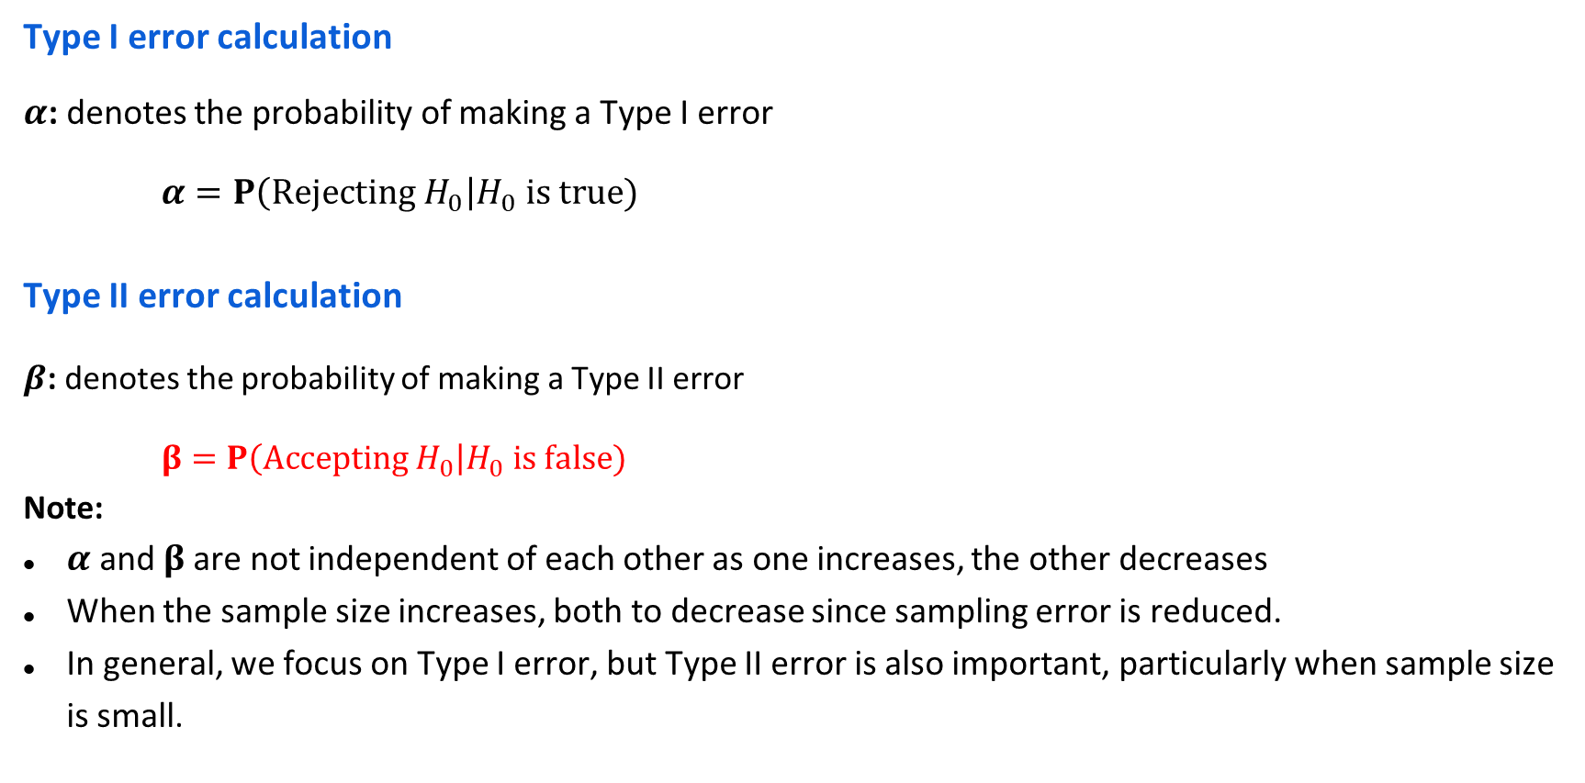
Probabilities of Making Errors
Type I error calculation
$α$: denotes the probability of making a Type I error
$α=P\left(Rejecting H_{0}\right|H_{0} is true)$
Type II error calculation
$β$: denotes the probability of making a Type II error
$β=P\left(Accepting H_{0}\right|H_{0} is false)$
Note:
$α$ and $β$ are not independent of each other as one increases, the other decreases
When the sample size increases, both to decrease since sampling error is reduced.
In general, we focus on Type I error, but Type II error is also important, particularly when sample size is small.

Slide 20
EXAMPLE 1
The mean lifetime of a sample of 100 light bulbs produced by a company is found to be 1560 hours with a population standard deviation of 90 hours.
Test the hypothesis that the mean life of the tubes produced by the company is 1580 hours

Slide 21
EXAMPLE 2
The mean lifetime of a sample of 100 light bulbs produced by a company is found to be 1560 hours with a population standard deviation of 90 hours.
Test the hypothesis that the mean life of the tubes produced by the company is more than 1580 hours

Slide 22
EXAMPLE 3
The mean lifetime of a sample of 100 light bulbs produced by a company is found to be 1560 hours with a population standard deviation of 90 hours.
Test the hypothesis that the mean life of the tubes produced by the company is less than 1580 hours

Slide 23
EXAMPLE 4
Prices of shares (in Rs.) of a company on different days in a month are given as
66,65,64,63,61,60,59,71,72,67
Will you conclude that the mean price of the shares is less than Rs.65 in the month

Slide 24
EXAMPLE 5
Two types of new cars produced in India are tested for petrol mileage. One sample consisting of 36 cars averaged 13 kmpl. While the other sample consisting of 72 cars averaged 11.5 kmpl, with population variances as 1.5 and 2.0 respectively.
Test whether there is any significant difference in the petrol consumption of these two types of cars. Use level of significance = 0.001

Slide 25
EXAMPLE 6
It is claimed that the mean of the population is 67 gms at 5% level of significance. Mean obtained from a random sample of size 100 is 64 with SD 3. Validate the claim.

Slide 26
Example 7
A telecom service provider claims that individual customers pay on an average at least Rs.400 per month with a standard deviation of Rs.25,
A random sample of 50 customers bills during a given month is with a mean of Rs.250 with a SD of Rs.15.
What to say w.r.t the claim made by the service provider?

Slide 27
Example 8
There is an assumption that there is no significant difference between boys and girls wrt intelligence. Tests are conducted on two groups and the following are the observations
Mean. SD. Size
Girls. 75. 8. 60
Boys. 73. 10. 100
Validate this at 5% LoS

Slide 28
Example 9
As a manager of finance you are assigned the task of choosing the best product in terms of life of the product.
Product A: Mean 1456 hours with SD 423, size 10
Product B: Mean 1280 hours with SD 398, size 17
Use 5% level of significance.

Slide 30
Example 10
Following is the record of number of accident took place during the various days of the week
Can we conclude that accident is independent of the day in a week?
MONDAY | Tuesday | Wednesday | Thursday | Friday | Saturday | Sunday
184 | 148 | 145 | 153 | 150 | 154 | 116

Slide 32
Example 11
Can we conclude that smoking causes cancer?
 | With Cancer | Without Cancer | Total
Smokers | 400 | 300 | 700
Non Smokers | 300 | 500 | 800
TOTAL | 700 | 800 | 1500

Slide 35
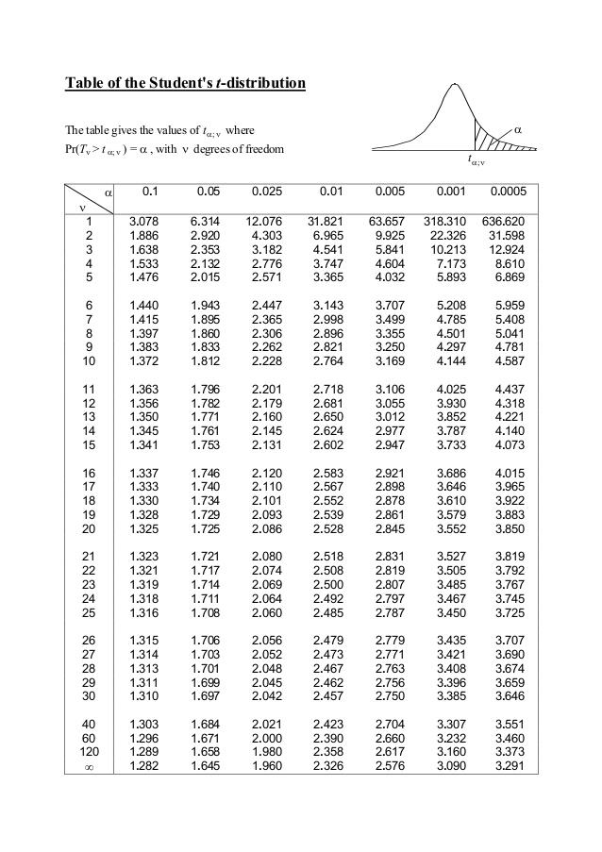

Slide 36
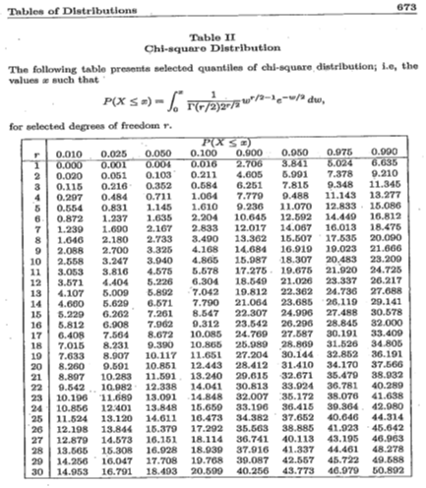

Slide 37
Session 11: Testing of Hypothesis(Cont..) and Correlation
II Semester 2019 -20(December 2020)

Slide 38
Learning objectives
Problems on Testing of Hypothesis
Chi Square test
Covariance
Correlation
Regression

Slide 39
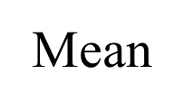
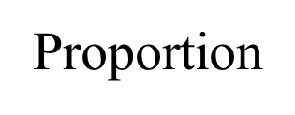

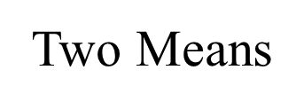
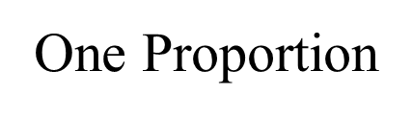
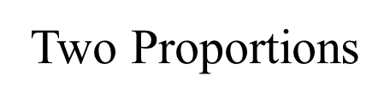
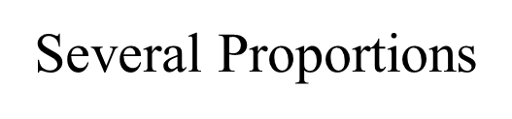
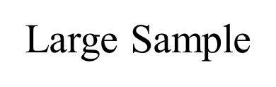
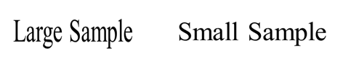
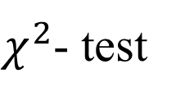
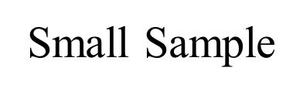

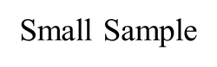
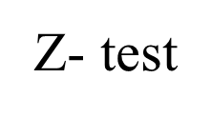
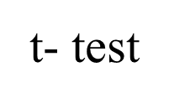
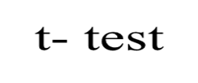

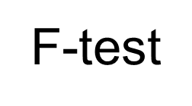
Testing of Hypothesis

Slide 40
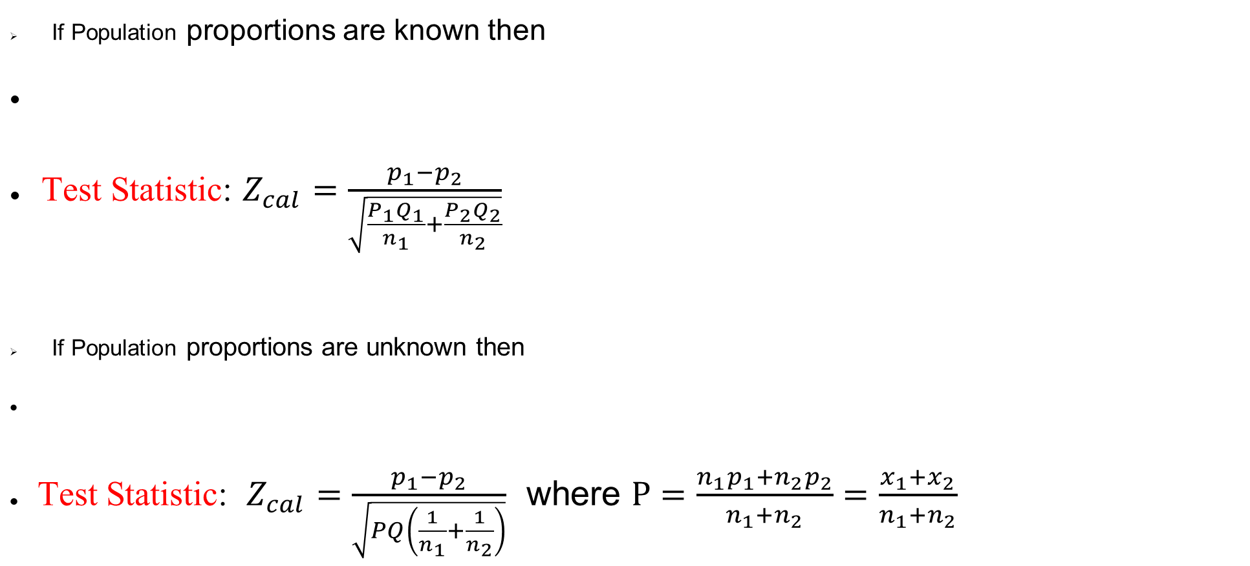
Large Samples (Two proportion)
If Population proportions are known then
Test Statistic: $Z_{cal}=\frac{p_{1}−p_{2}}{\sqrt{\frac{P_{1}Q_{1}}{n_{1}}+\frac{P_{2}Q_{2}}{n_{2}}}}$
If Population proportions are unknown then
Test Statistic: $Z_{cal}=\frac{p_{1}−p_{2}}{\sqrt{PQ\left(\frac{1}{n_{1}}+\frac{1}{n_{2}}\right)}}$ where $P=\frac{n_{1}p_{1}+n_{2}p_{2}}{n_{1}+n_{2}}=\frac{x_{1}+x_{2}}{n_{1}+n_{2}}$

Slide 41
Problem
It is thought that the front cover and the nature of the first question on mail surveys influence the response rate. The article “The Impact of Cover Design and First Questions on Response Rates for a Mail Survey of Skydivers” (Leisure
Sciences, 1991: 67–76) tested this theory by experimenting with different cover designs. One cover was plain; the other used a picture of a skydiver. The researchers speculated that the return rate would be lower for the plain cover.
Does this data support the researchers’ hypothesis?
Cover | Number Sent | Number Returned
Plain | 207 | 104
Skydiver | 213 | 109

Slide 42
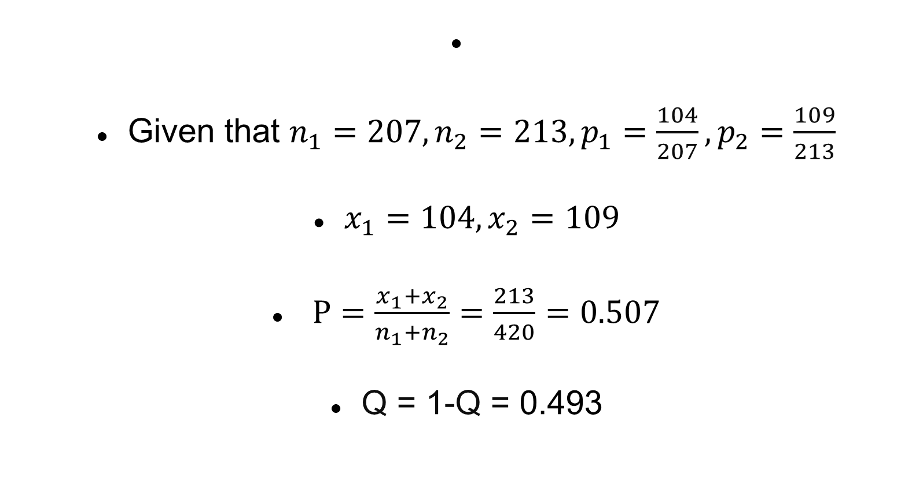
Solution
Given that $n_{1}=207,n_{2}=213,p_{1}=\frac{104}{207},p_{2}=\frac{109}{213}$
$x_{1}=104,x_{2}=109$
$P=\frac{x_{1}+x_{2}}{n_{1}+n_{2}}=\frac{213}{420}=0.507$
Q = 1-Q = 0.493

Slide 43
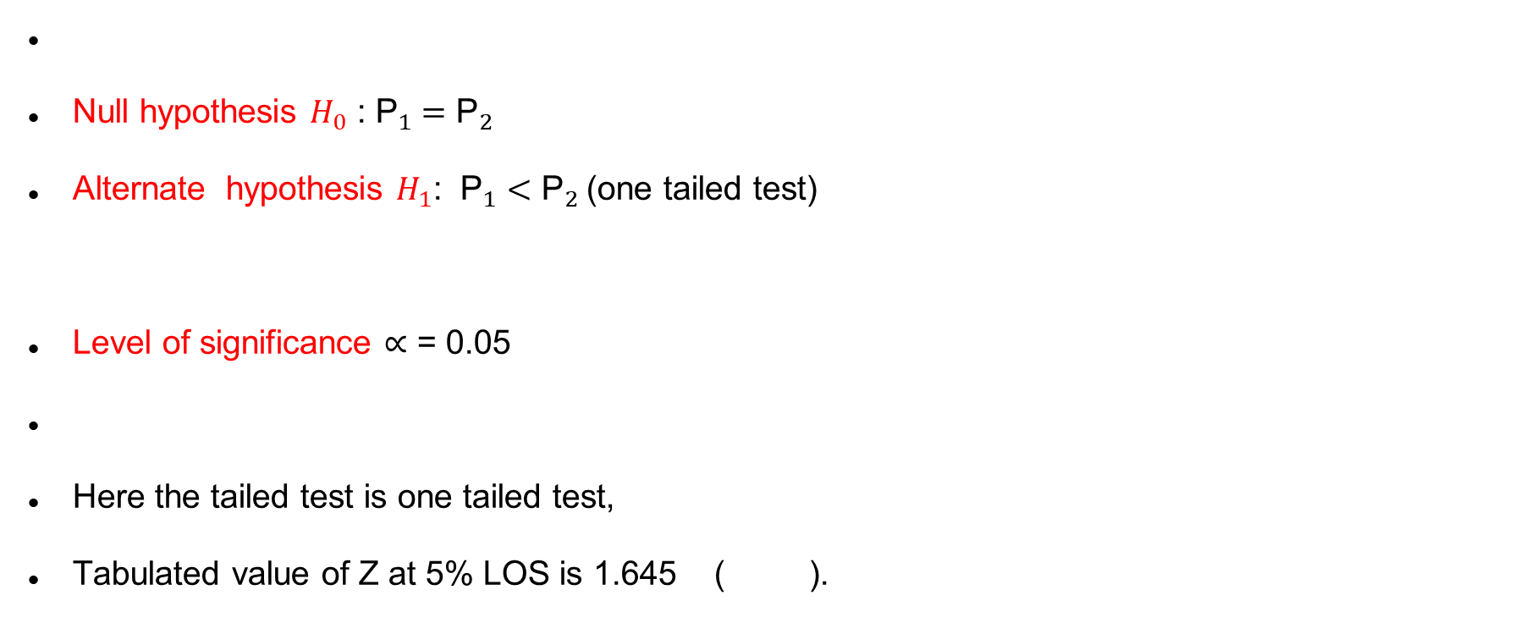
Solution
Null hypothesis $H_{0}$ : ${\text{P}}_{1}={\text{P}}_{2}$
Alternate hypothesis $H_{1}$: ${\text{P}}_{1}<{\text{P}}_{2}$(one tailed test)
Level of significance ∝ = 0.05
Here the tailed test is one tailed test,
Tabulated value of Z at 5% LOS is 1.645 ( ).

Slide 44
Solution
Test Statistic:
Here at α = 1 % LOS.
Decision : we accept the Null hypothesis at α = 1 % LOS.

Slide 45
Problem
The article “Effect of Internal Gas Pressure on the Compression Strength of Beverage Cans and Plastic Bottles” (J. of Testing and Evaluation, 1993: 129–131) includes the accompanying data on compression strength (lb) for a sample of 15-oz aluminium cans filled with strawberry drink and another sample filled with cola.
Does the data suggest that the extra carbonation of cola results in a higher average compression strength?
 | sample size | sample mean | sample SD
Strawberry drink | 15 | 540 | 21
Cola | 15 | 554 | 15

Slide 46
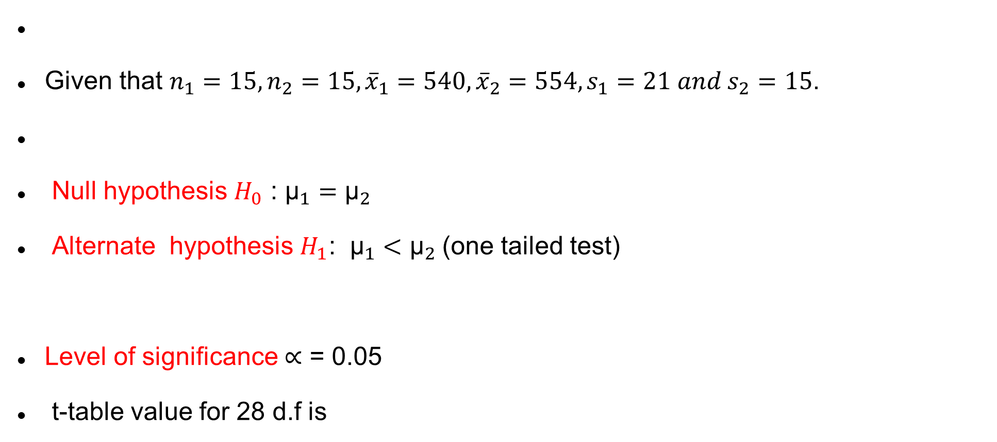
Solution
Given that $n_{1}=15,n_{2}=15,{\overline{x}}_{1}=540,{\overline{x}}_{2}=554,s_{1}=21 and s_{2}=15$.
Null hypothesis $H_{0}$ : ${\text{μ}}_{1}={\text{μ}}_{2}$
Alternate hypothesis $H_{1}$: ${\text{μ}}_{1}<{\text{μ}}_{2}$(one tailed test)
Level of significance ∝ = 0.05
t-table value for 28 d.f is

Slide 47
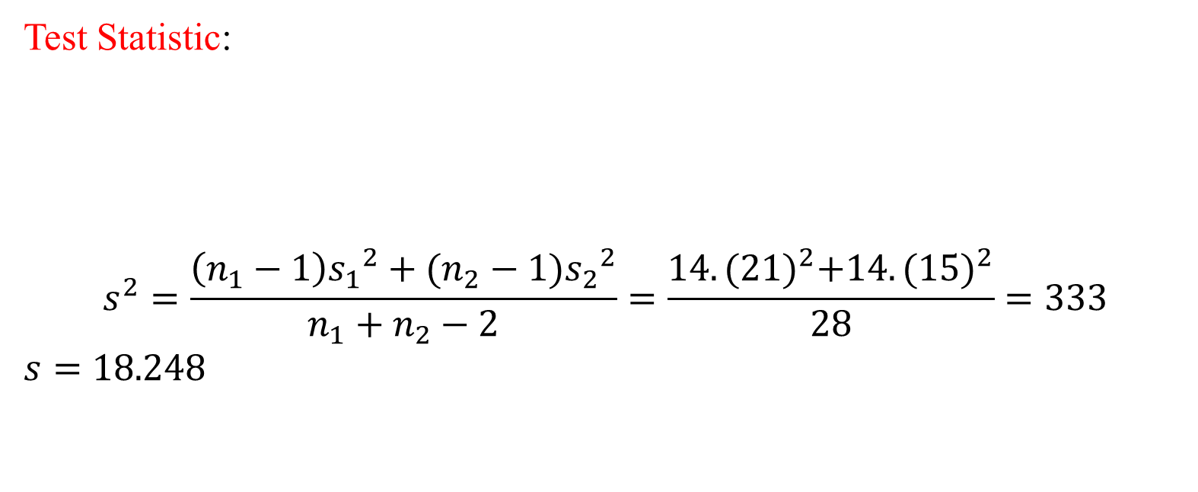
Solution
Test Statistic:
$$s^{2}=\frac{\left(n_{1}−1\right){s_{1}}^{2}+(n_{2}−1){s_{2}}^{2}}{n_{1}+n_{2}−2}=\frac{14.{(21)}^{2}+14.{(15)}^{2}}{28}=333$$
$s=18.248$

Slide 48
Solution
Here at α = 5 % LOS.
Decision : we reject the Null hypothesis at α = 5 % LOS.
i.e, we accept .

Slide 49
Problem
A sample analysis of examination results of 500 students was made. It was found that 220 students had failed, 170 had secured a third class, 90 were placed in second class and 20 got a first class.
Do these figures commensurate with the general examination result which is in ratio of 4:3:2:1 for the various categories respectively.

Slide 50
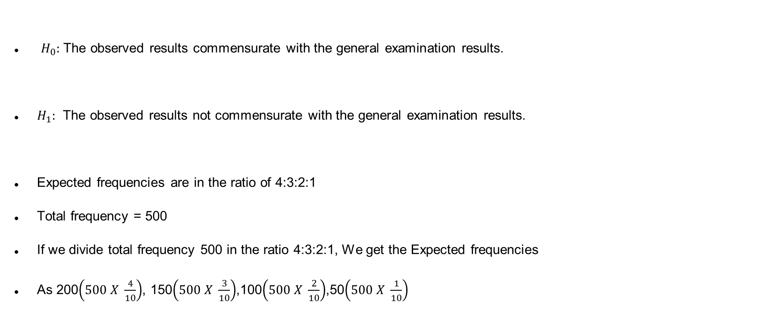
Solution
$H_{0}:$ The observed results commensurate with the general examination results.
$H_{1}:$ The observed results not commensurate with the general examination results.
Expected frequencies are in the ratio of 4:3:2:1
Total frequency = 500
If we divide total frequency 500 in the ratio 4:3:2:1, We get the Expected frequencies
As 200$\left(500 X \frac{4}{10}\right)$, 150$\left(500 X \frac{3}{10}\right)$,100$\left(500 X \frac{2}{10}\right)$,50$\left(500 X \frac{1}{10}\right)$

Slide 51
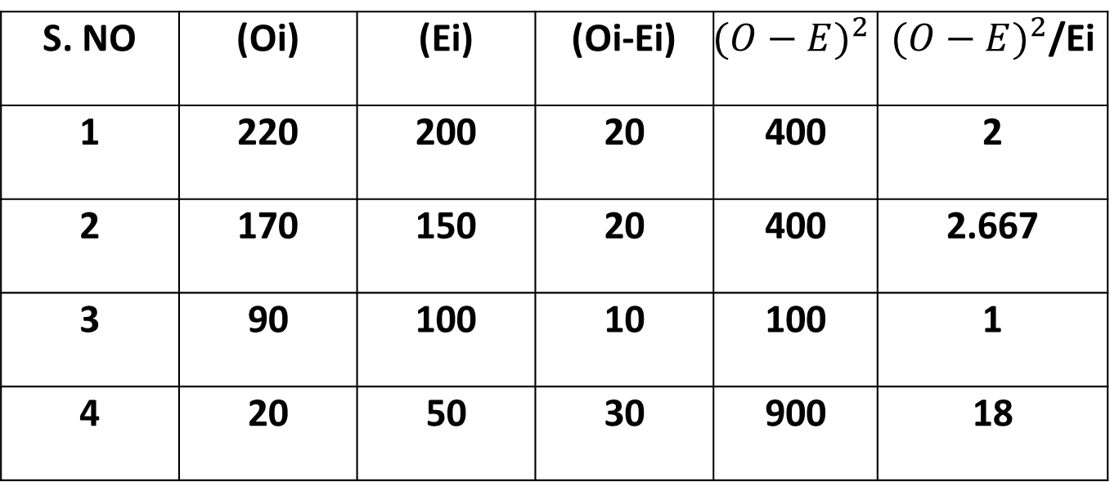
S. NO | (Oi) | (Ei) | (Oi-Ei) | $${(O−E)}^{2}$$ | ${(O−E)}^{2}$/Ei
1 | 220 | 200 | 20 | 400 | 2
2 | 170 | 150 | 20 | 400 | 2.667
3 | 90 | 100 | 10 | 100 | 1
4 | 20 | 50 | 30 | 900 | 18

Slide 52
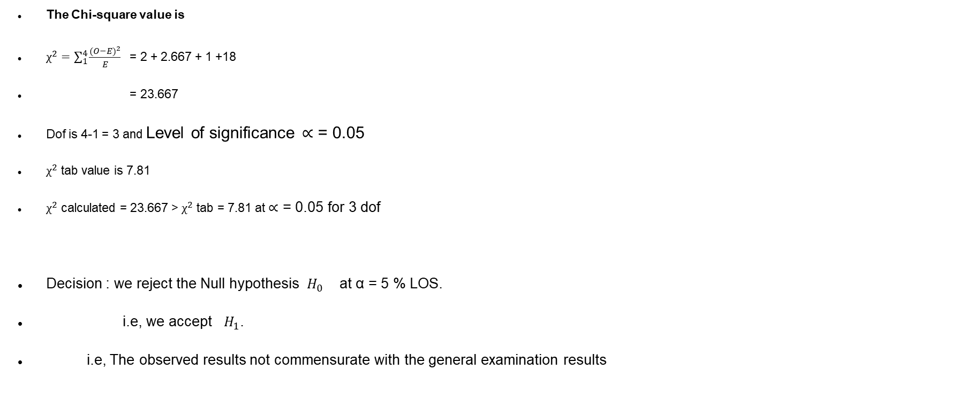
The Chi-square value is
$χ^{2}=\sum_{1}^{4}{\frac{{(O−E)}^{2}}{E}}$ = 2 + 2.667 + 1 +18
= 23.667
Dof is 4-1 = 3 and Level of significance ∝ = 0.05
$χ^{2}$ tab value is 7.81
$χ^{2}$ calculated = 23.667 > $χ^{2}$ tab = 7.81 at ∝ = 0.05 for 3 dof
Decision : we reject the Null hypothesis $H_{0}$ at α = 5 % LOS.
i.e, we accept $H_{1}$.
i.e, The observed results not commensurate with the general examination results

Slide 53
Example
Can we conclude that smoking causes cancer?
 | With Cancer | Without Cancer | Total
Smokers | 400 | 300 | 700
Non Smokers | 300 | 500 | 800
TOTAL | 700 | 800 | 1500

Slide 56
Correlational Analysis

Slide 57
When two or more variables are studied it is essential to find out whether there is any relationship between these variables, if so, then need to know
▪ what nature of relationship?
▪ what extent they are related?

Slide 58
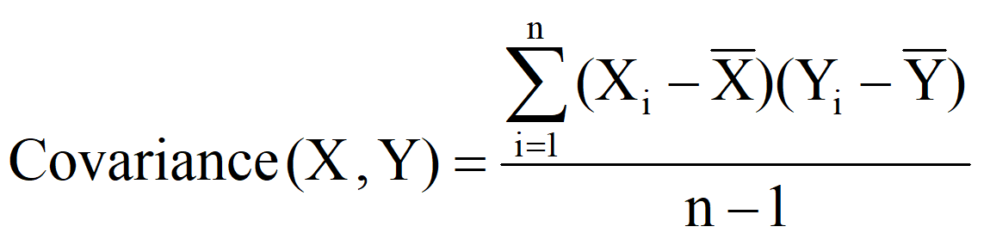
Covariance
The statistical technique used for studying the existence and extent of relationship between variables is through Covariance

Slide 59
If X₁, X₂, …, X_{n} are n variables, then the Covariance between these n variables is the Variance – Covariance matrix given by
All diagonal elements in the variance-covariance matrix are variances and off diagonal elements are covariances.
Σ is a symmetric matrix.

Slide 60
EXAMPLE
Find the covariance between age (months) and weight (kgs) for the following data
9 | 6 | 5 | 8 | 6 | 7 | Age (years)
13 | 11 | 10 | 12 | 8 | 12 | Weight (kgs)

Slide 61
Age (yrs) (X) | Weight (kgs) (Y)
5 | 20 | -2 | -3 | 6
4 | 18 | -3 | -5 | 15
7 | 23 | 0 | 0 | 0
10 | 32 | 3 | 9 | 27
8 | 26 | 1 | 3 | 3
8 | 25 | 1 | 2 | 2

Slide 62
Covariance based on Probability distribution.
If X and Y are two random variables with probability mass function p(x)/ probability density function f(x), then the covariance between X and Y
Cov (X, Y) = E[(X-µ_{X})(Y-µ_{Y})] = E(XY) – E(X)E(Y)
where E(X) = µ_{X} and E(Y) = µ_{Y} are the means of X and Y.

Slide 63
Karl Pearson’s Correlation coefficient
Karl Pearson’s product moment correlation returns a numerical value, popularly known as Coefficient of Correlation, denoted by ‘r’
Correlation coefficient is a statistic that assesses the strength and direction of relationship of two continuous variables

Slide 64
Mathematically the following measures are used to find out the degree of relationship between the variables
♦ Karl Pearson’s product moment correlation
♦ Spearman’s rank correlation
The numerical value obtained by the above methods is called correlation coefficient

Slide 65
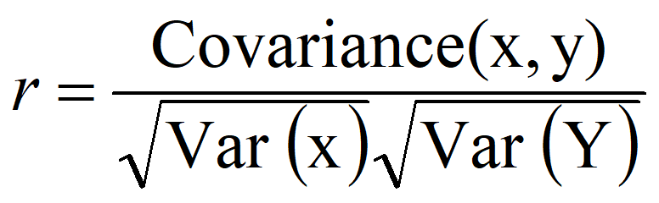
Karl Pearson’s Correlation coefficient
Formula for computing Karl Pearson’s correlation coefficient (r) is standardised covariance (unit less)

Slide 66
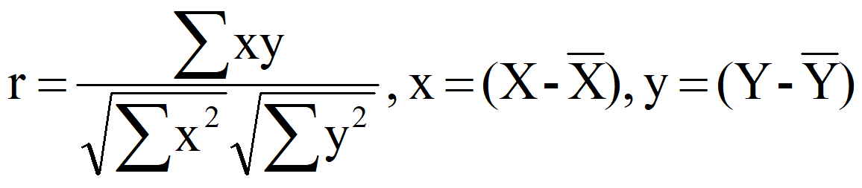
Or alternatively we can use

Slide 67
The sign of ‘r’ denotes the nature of association
The value of ‘r’ denotes the strength of association.

Slide 68
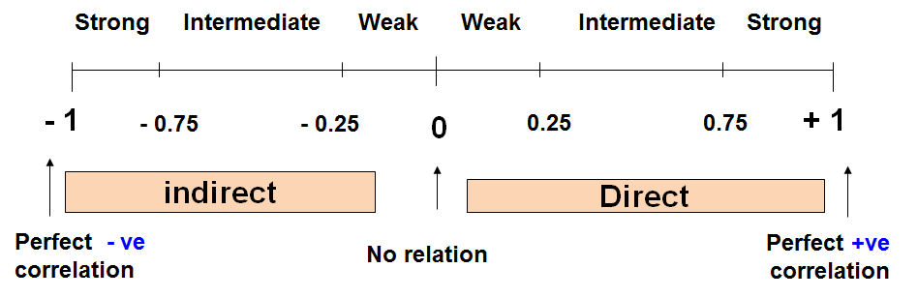

Slide 69
Weight (Kg) | Age (yrs) | Serial No
12 | 7 | 1
8 | 6 | 2
12 | 8 | 3
10 | 5 | 4
11 | 6 | 5
13 | 9 | 6

Slide 70
Y² | X² | XY | Wt (Kg) (Y) | Age (yrs) (X) | Sl no.
144 | 49 | 84 | 12 | 7 | 1
64 | 36 | 48 | 8 | 6 | 2
144 | 64 | 96 | 12 | 8 | 3
100 | 25 | 50 | 10 | 5 | 4
121 | 36 | 66 | 11 | 6 | 5
169 | 81 | 117 | 13 | 9 | 6
∑Y²= 742 | ∑X²= 291 | ∑XY= 461 | ∑Y=66 | ∑X=41 | Total

Slide 71
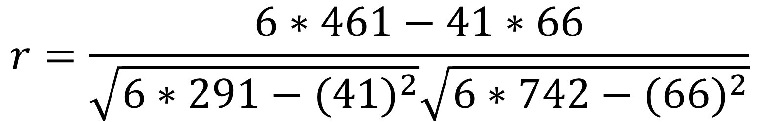
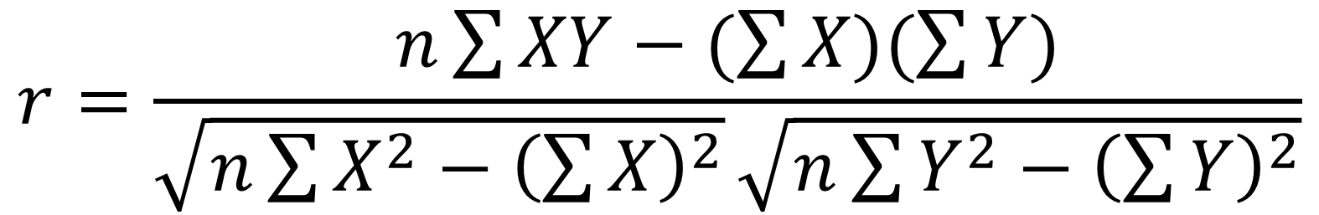
$$r=\frac{n\sum{XY−(\sum{X)(\sum{Y)}}}}{\sqrt{n\sum{X^{2}−{\left(\sum{X}\right)}^{2}}}\sqrt{n\sum{Y^{2}−{\left(\sum{Y}\right)}^{2}}}}$$
$$r=\frac{6∗461−41∗66}{\sqrt{6∗291−({41)}^{2}}\sqrt{6∗742−({66)}^{2}}}$$
r = 0.759 (Positive (Direct) strong correlation)

Slide 72
Example: Relationship between anxiety and test Scores
Anxiety (X) | Test score (Y) | X² | Y² | XY
10 | 2 | 100 | 4 | 20
8 | 3 | 64 | 9 | 24
2 | 9 | 4 | 81 | 18
1 | 7 | 1 | 49 | 7
5 | 6 | 25 | 36 | 30
6 | 5 | 36 | 25 | 30
∑X = 32 | ∑Y = 32 | ∑X² = 230 | ∑Y² = 204 | ∑XY= 129

Slide 73
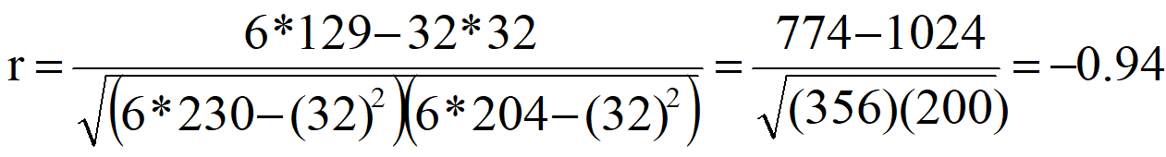
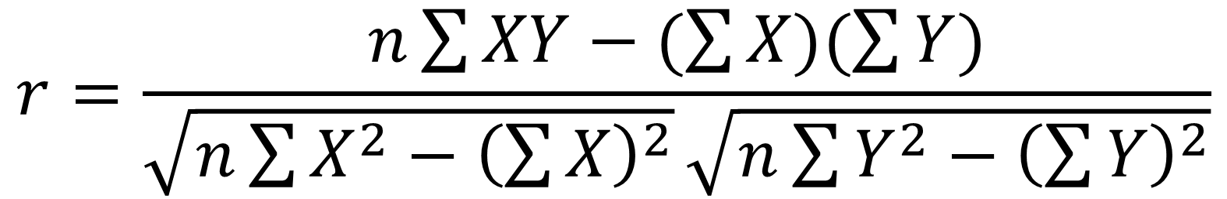
Statistical Technique for Data Sciences
$$r=\frac{n\sum{XY−(\sum{X)(\sum{Y)}}}}{\sqrt{n\sum{X^{2}−{\left(\sum{X}\right)}^{2}}}\sqrt{n\sum{Y^{2}−{\left(\sum{Y}\right)}^{2}}}}$$
r = - 0.94 (Negative (Indirect) strong correlation )

Slide 74
Spearman’s Rank Correlation coefficient
Rank the values of X with the smallest value as rank 1,
next value as rank 2 and so on,
assign rank n for the largest value.
If there any tied values assign average ranks.
The ranks can be assigned in the reverse order
Rank the values of Y as done for X separately.

Slide 75
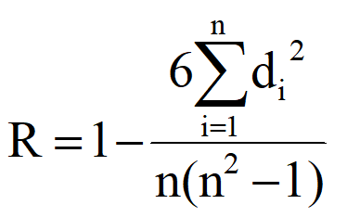
Compute the value of d_{i} for each pair of observation by subtracting the rank of Y_{i} from the rank of X_{i}
Square each d_{i} and compute ∑d²_{i} which is the sum of the squared values.
Where d = R_{x} – R_{y}, R_{x} = Rank of X values; R_{y} Rank of Y values

Slide 76
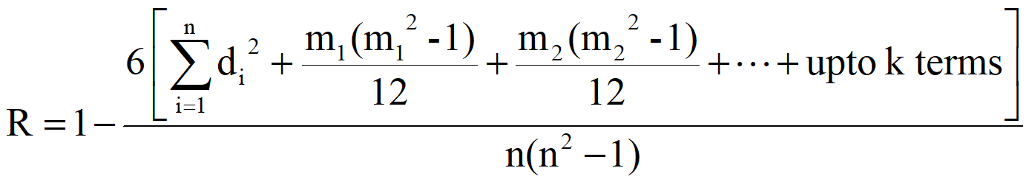
In case of tied observation, the formula for calculation of R is
Where m₁, m₂, ..., is the number of times a value of X or Y repeats

Slide 77
Spearman’s Rank Correlation coefficient
Example
In this example, we will use the raw data in the table below to calculate the correlation between the IQ of a person with the number of hours spent in front of TV per week
Intelligent Quotient | 106 | 86 | 100 | 101 | 99 | 103 | 97 | 113 | 112 | 110
Hours of TV watching | 7 | 0 | 27 | 50 | 28 | 29 | 20 | 12 | 6 | 17

Slide 78
Intelligent Quotient (X) | Hours of TV watching (Y) | Rank X (R_{x}) | Rank Y (R_{y}) | d = R_{x} - R_{y} | d²
86 | 0 | 1 | 1 | 0 | 0
97 | 20 | 2 | 6 | − 4 | 16
99 | 28 | 3 | 8 | − 5 | 25
100 | 27 | 4 | 7 | − 3 | 9
101 | 50 | 5 | 10 | − 5 | 25
103 | 29 | 6 | 9 | − 3 | 9
106 | 7 | 7 | 3 | 4 | 16
110 | 17 | 8 | 5 | 3 | 9
112 | 6 | 9 | 2 | 7 | 49
113 | 12 | 10 | 4 | 6 | 36

Slide 79
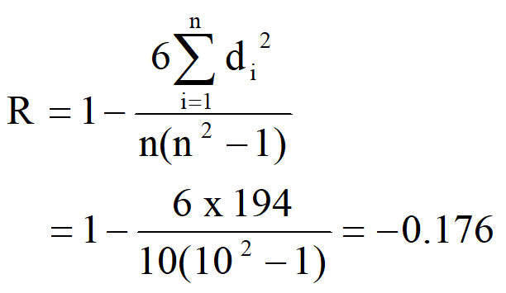
With d_{i}² found, we can add them to find ∑d_{i}² = 194.
The value of n is 10. So these values can now be substituted back into the equation, which evaluates to
This low value shows that there is a negative correlation between IQ and hours spent watching TV is very low.

Slide 80
Example
Find rank correlation between distance and price
Convenience Store | 1 | 2 | 3 | 4 | 5 | 6 | 7 | 8 | 9 | 10
Distance (m) | 50 | 175 | 175 | 375 | 425 | 580 | 710 | 790 | 890 | 980
Price of 50cl bottle (Rs) | 1.80 | 1.20 | 2.00 | 1.00 | 1.00 | 1.20 | 0.80 | 0.60 | 1.00 | 0.85

Slide 81
Regression Analysis

Slide 82
x | y
1 | 1
3 | 3
5 | 5
6 | 6
8 | 8

Slide 83
x | y
1 | 1
3 | 3
5 | 5
6 | 6
8 | 8

Slide 84
x | y
1 | 1
2 | 4
3 | 9
4 | 16
5 | 25

Slide 85
x | y
1 | 1
2 | 4
3 | 9
4 | 16
5 | 25

Slide 86
x | y
1 | 1
2 | 5
3 | 2
4 | 8
5 | 15
6 | 10
7 | 15

Slide 87
x | y
1 | 1
2 | 5
3 | 2
4 | 8
5 | 15
6 | 10
7 | 15

Slide 88
x | y
1 | 1
2 | 5
3 | 2
4 | 8
5 | 15
6 | 10
7 | 15

Slide 89
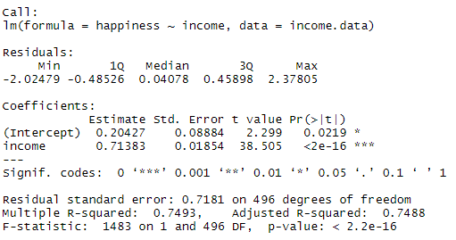

Slide 90
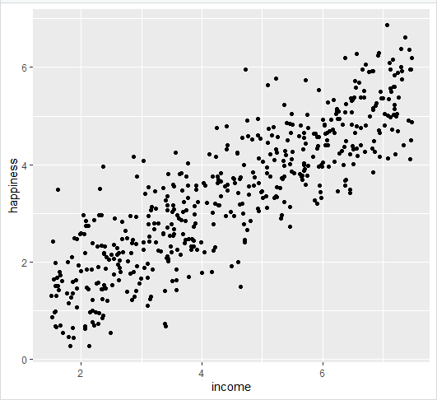

Slide 91
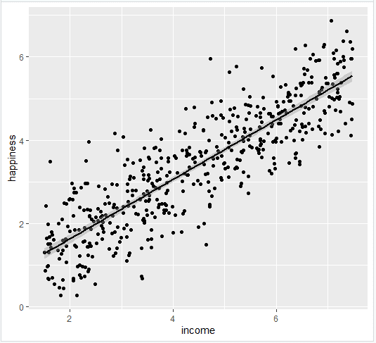

Slide 92
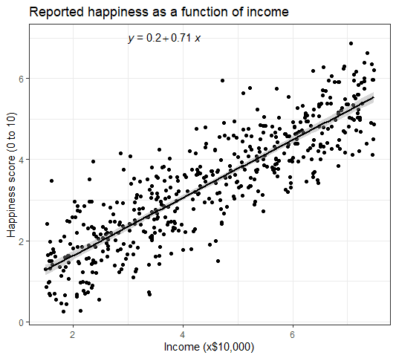

Slide 93
What is regression analysis?
y = f(x)

Slide 94
x | y
1 | 1
2 | 5
3 | 2
4 | 8
5 | 15
6 | 10
7 | 15

Slide 97


Slide 98





Slide 100


Coefficient of Determination
where:
SST = Sum of Squares due to Total
SSR = Sum of Squares due to Regression
SSE = Sum of Squares due to Error

Slide 101

where:
SST = Sum of Squares due to Total
SSR = Sum of Squares due to Regression

Slide 102
Statistical Methods for Data Sciences
Example
No. of TV advs (X) | No. of cars sold (Y)
1 | 14
3 | 24
2 | 18
1 | 17
3 | 27
2 | 20
Fit a regression line of Y on X and determine the coefficient of determination

Slide 103


Statistical Methods for Data Sciences
Regression Analysis
Simple Linear Regression
 | X | Y | x = (X-2) | y = (Y-20) | xy | x² | (Y-20)² | Y^ = 10 + 5X | (Y^ - 20)²
 | 1 | 14 | -1 | -6 | 6 | 1 | 36 | 15 | 25
 | 3 | 24 | 1 | 4 | 4 | 1 | 16 | 25 | 25
 | 2 | 18 | 0 | -2 | 0 | 0 | 4 | 20 | 0
 | 1 | 17 | -1 | -3 | 3 | 1 | 9 | 15 | 25
 | 3 | 27 | 1 | 7 | 7 | 1 | 49 | 25 | 25
Total | 10 | 100 | 0 | 0 | 20 | 4 | 114 |  | 100
Regression y on X
Coefficient of Determination

Slide 104
Statistical Methods for Data Sciences
SL. No | X | Y | x = (X-2) | y = (Y-20) | xy | x² | (Y-20)² | Y^ = 10 + 5X | (Y^ - 20)²
1 | 1 | 14 | -1 | -6 | 6 | 1 | 36 | 15 | 25
2 | 3 | 24 | 1 | 4 | 4 | 1 | 16 | 25 | 25
3 | 2 | 18 | 0 | -2 | 0 | 0 | 4 | 20 | 0
4 | 1 | 17 | -1 | -3 | 3 | 1 | 9 | 15 | 25
5 | 3 | 27 | 1 | 7 | 7 | 1 | 49 | 25 | 25
Total | 10 | 100 | 0 | 0 | 20 | 4 | 114 |  | 100
Regression y on X
Coefficient of Determination

Slide 105
Interpretation
The regression relationship is very strong; 87.72% of the variability in the number of cars sold can be explained by the linear relationship between the number of TV ads and the number of cars sold

Slide 110





Slide 111
Multiple Linear Regression

Slide 114
How to model
Sales and advertisement on TV, News Paper ,Radio
Few Guidelines
- keep the variables with low p – values and eliminate the ones
with high p – values
- inclusion of a variable to the model should ideally increase
the value of R – Squared

Slide 115
an idea
Forward Selection
Backward selection

Slide 116
Name | Definition | R^2/Adj R^2 | F-Statistic | P – value | RSE
Model 1 | Sales – TV | 0.612/0.610 | 312.1 | 1.47exp(-42) | 3.25(23%)
Model 2 | Sales – TV + News Paper | 0.646/0.642 | 179.6 | 3.95exp(-42) | 3.12(22%)
Model 3 | Sales – TV+ Radio | 0.897/0.896 | 859.6 | 4.83exp(-42) | 1.71(12%)
Model 4 | Sales – TV+ Radio + News Paper | 0.897/0.896 | 570.3 | 1.58exp(-42) | 1.80(13%)

Slide 122
Accuracy of a model
By Using the following the strength of the linear model can be tested
Coefficient of determination
Residual Standard error

Slide 126
R – Squared vs Adjusted R - Squared
In multiple regression, adjusted R – squared is better metric than R – squared asses the goodness of fit of the model
R – squared always increases if additional variables are added into model , even if they are not related to the dependent variable

Slide 127
Regularization
Over fitting can be solved with regularization
Regularization can be done by putting constraints on the coefficients and variables.
LASSO: Least Absolute Shrinkage and Selection Operator
Some coefficients can be dropped( i.e become zero)
RIDGE: The coefficients will approach zero, but never dropped

Slide 128
Lasso & Ridge
OLS estimation:
LASSO estimation:
Ridge regression estimation:

Slide 129
LOGISTIC REGRESSION

Slide 130
Logistic Regression
In many regression settings, the Y variable is (0,1)
A Few Examples:
Consumer chooses brand (1) or not (0);
A quality defect occurs (1) or not (0);
A person is hired (1) or not (0);
Evacuate home during hurricane (1) or not (0);
Other Examples???

Slide 131
Statistical Technique for Data Sciences
The Linear Probability Model (LPM)
If we estimate the slope using OLS regression:
Hired = α + β*Income + e ;
The result is called a “Linear Probability Model”
The predicted values are probabilities that Y equals 1;
The equation is linear – the slope is constant

Slide 132


Statistical Technique for Data Sciences
Model development
The estimated probability P(Y) with one predictor variable is given by
and

Slide 133


Relationship between Odds & Probability

Slide 140

Binary Logistic Regression Model
Y = Binary response
X = Quantitative predictor
p = proportion of 1’s (yes, success) at any X
Equivalent forms of the logistic regression model:
Logit form
Probability form

Slide 141
Binary Logistic Regression Model
Y = Binary response
X₁,X₂,…,X_{k} = Multiple predictors
X = Single predictor
π = proportion of 1’s (yes, success) at any x
π = proportion of 1’s at any x₁, x₂, …, x_{k}
Equivalent forms of the logistic regression model:
Logit form
Probability form

Slide 142
Thanks

Slide 143
Introduction to Statistical Methods
Dr Y V K Ravi Kumar, BITS- Pilani

Slide 144
Session 13: REGRESSION & LOGISTIC REGRESSION
II Semester 2019 -20(December 2020)

Slide 145
Assumptions of the Linear Regression
Assumptions about the Error
E(ε_{i} ) = 0 for i = 1, 2,…,n.
σ(ε_{i} ) = σ_{ε} where σ_{ε} is unknown.
The errors are independent, that is, the error in the ith observation is independent of the error observed in the jth observation.
The ε_{i} are normally distributed (with mean 0 and standard deviation σ_{ε}).

Slide 146


Slide 147
Session 14: TIME SERIES ANALYSIS
(JANUARY 2021)

Slide 148
Forecasting
Predict the next number in the pattern:
a) 3.7, 3.7, 3.7, 3.7, 3.7, ?
b) 2.5, 4.5, 6.5, 8.5, 10.5, ?
c) 5.0, 7.5, 6.0, 4.5, 7.0, 9.5, 8.0, 6.5, ?

Slide 149
Forecasting
Predict the next number in the pattern:
a) 3.7, 3.7, 3.7, 3.7, 3.7,
b) 2.5, 4.5, 6.5, 8.5, 10.5,
c) 5.0, 7.5, 6.0, 4.5, 7.0, 9.5, 8.0, 6.5,
3.7
12.5
9.0

Slide 150
Introduction
Government sees lowering demand for oil
The amazon sales in India are expected to increase by 20% next quarter
The population of India will stabilize by 2050
The BSE index is likely to breach the 40000 mark in one year time
The monsoon rains will be lower this season. Likely to remain at 95% of the long term average
So how are these forecasts arrived at?
We will focus on forecasting for a time-series data.
Time-series data are data gathered on a given characteristic over a period of time at regular intervals

Slide 151
Time Series
Arrangement of data in chronological order(i.e. in accordance with the occurrence of time) is known as Time Series

Slide 152
The forecasting Process

Slide 153
Time Series Analysis
What is time series
Why time series
Components in time series
Methods / models in time series

Slide 154
What is a Time Series?
Set of evenly spaced numerical data
Obtained by observing response variable at regular time periods
Forecast based only on past values
Assumes that factors influencing past, present, & future will continue
Example
Year: 1995 1996 1997 1998 1999
Sales: 78.7 63.5 89.7 93.2 92.1
Notes:
16

Slide 155
Why Time Series?
To detect patterns of change over regular intervals of time.
Predict for the future intervals of time
Notes:
16

Slide 156
Applications
Retail sales
Spare parts planning
Stock trading

Slide 157
Time series _ components
A _ Trend
B_ Cyclicality
Seasonality
C _ Random / irregularity

Slide 158
Time Series Models
Forecaster looks for data patterns as
Data = historic pattern + random variation
Historic pattern to be forecasted:
Level (long-term average) – data fluctuates around a constant mean
Trend – data exhibits an increasing or decreasing pattern
Seasonality – any pattern that regularly repeats itself and is of a constant length
Cycle – patterns created by economic fluctuations
Random Variation cannot be predicted

Slide 159
Time series data that shows no trend, seasonality and cyclicality is said to be stationary.
The statistical properties of such a time series are independent of time.
i.e
The process generating the data has a constant mean
The variability is constant over time

Slide 160
Notes:
160

Slide 162
Quantitative Forecasting Methods
Quantitative
Forecasting
Time Series
Causal
Models
Models
Moving
Exponential
Trend
Regression
Average
Smoothing
Models
Notes:
15

Slide 163

Time Series Patterns

Slide 164
Box – Jenkins Methodology
Condition data and select a model
identify and account for any trends or seasonality in the time series
examine the remaining time series and determine a suitable model
Estimate the model parameters
Assess the model and return to step 1,if necessary

Slide 165
Time Series Components
A time series can be described by models based on the following components
T_{t} Trend Component
S_{t} Seasonal Component
C_{t} Cyclical Component
I_{t} Irregular Component
Using these components we can define a time series as the sum of its components or an additive model
Alternatively, in other circumstances we might define a time series as the product of its components or a multiplicative model – often represented as a logarithmic model

Slide 166
Smoothing Methods

Slide 167
Moving Average Models
Simple Moving Average Forecast
Weighted Moving Average Forecast

Slide 168
Example(Moving averages)
Use the following data to compute three year moving average for all available years. Find the trend and Forecast error
YEAR | Saleson (Lakhs) | YEAR | Saleson (Lakhs)
2008 | 21 | 2013 | 22
2009 | 22 | 2014 | 25
2010 | 23 | 2015 | 26
2011 | 25 | 2016 | 27
2012 | 24 | 2017 | 26

Slide 170
Time Series Models
Weighted Moving Average:
All weights must add to 100% or 1.00
e.g. Ct .5, Ct-1 .3, Ct-2 .2 (weights add to 1.0)
Allows emphasizing one period over others; above indicates more weight on recent data (Ct=.5)
Differs from the simple moving average that weighs all periods equally - more responsive to trends

Slide 171
Example(Weighted moving Averages)
Weights | Month
3 | Last month
2 | Two months ago
1 | Three months ago
Months | 1 | 2 | 3 | 4 | 5 | 6 | 7 | 8 | 9 | 10 | 11 | 12
Sales | 10 | 12 | 13 | 16 | 19 | 23 | 26 | 30 | 28 | 18 | 16 | 14

Slide 174
Time Series Models
Exponential Smoothing:
Most frequently used time series method because of ease of use and minimal amount of data needed
Need just three pieces of data to start:
Last period’s forecast (Ft)
Last periods actual value (At)
Select value of smoothing coefficient, ,between 0 and 1.0
If no last period forecast is available, average the last few periods or use naive method
Higher values may place too much weight on last period’s random variation

Slide 175
Example
Forecast for the first week of March 1 was 500 units whereas the actual demand is 450 units
Forecast demand for the next week i. e March 8
Assume the actual demand during the march is 505 units
Continue the forecasting assuming that subsequent demands were actually 516, 488,467,554 and 510 units

Slide 178
Measuring Forecasting Accuracy
Mean Absolute Deviation (MAD)
measures the total error in a forecast without regard to sign
Cumulative Forecast Error (CFE)
Measures any bias in the forecast
Mean Square Error (MSE)
Penalizes larger errors
Tracking Signal
Measures if your model is working

Slide 182
Selecting the Right Forecasting Model
The amount & type of available data
Some methods require more data than others
Degree of accuracy required
Increasing accuracy means more data
Length of forecast horizon
Different models for 3 month vs. 10 years
Presence of data patterns
Lagging will occur when a forecasting model meant for a level pattern is applied with a trend

Slide 186
AR Model (auto regressive Model)

Slide 187
AR model

Slide 188
MA model (Moving averages model)

Slide 189
MA model

Slide 190
ARMA model

Slide 191
ARMA model –ARMA(p,q)

Slide 192
ARIMA model (Autoregressive Integrated Moving Average Model)

Slide 195
In implementation
Import the data
Convert it into time series
Plot the time series
Plot ACF and PACF
Then fit the model

Slide 196
Thanks

Slide 197
Introduction to Statistical Methods
Dr Y V K Ravi Kumar, BITS- Pilani

Slide 198
Session 16: ANOVA & Revision
(JANUARY 2021)

Slide 199
Case
Testing the impact of nutrition and exercise on 60 candidates between age 18 and 50.They are grouped with different strategies.Now we need to find the most effective strategy
Group 1 eats only junk food
Group 2 eats only healthy food
Group 3 eats junk food &does cardio exercise every other day
Group 4 eats healthy food & does cardio ……………
Group 5 eats junk food& does both cardio & strength training every other day
Group 6 eats healthy food…….

Slide 200
ANOVA
Effectiveness of different promotional activities
Quality of a product produced by different manufacturers in terms of an attribute
Yield of crop due to varieties of seeds , fertilisers and quality of soil

Slide 201
ANOVA-analysis of variance
* Significance of difference between two sample means

Slide 202
Assumptions
Each population is normally distributed with mean With equal variances
Each sample is drawn randomly and independent of other samples

Slide 204
ANOVA summary

Slide 205
Short cut method

Slide 206
Example
To test the significance of variation in the retail prices of a commodity in three metro cities,Mumbai,Kolkata and Delhi, four shops are chosen at random and the prices are given below

Slide 207
Example
A study was conducted to investigate the perception of corporate ethical values among individuals specialising in marketing. Using 0.05 level of significance and the data given below, test for significant differences in perception among three groups.( higher scores indicate higher ethical values)

Slide 212
Two way ANOVA

Slide 213
Example

Slide 221
Thanks

